Slide 1


Predicting individual driving habits

Slide 2

Problem
Current navigation systems provide estimated travel times based on generic averages, often leading to inaccurate predictions for individual drivers. These estimates fail to consider personal driving habits, preferred routes, and historical travel patterns. Our goal is to develop a model that predicts a rider’s travel time more accurately by leveraging their past driving data, ensuring a more personalized and precise ETA.

Slide 3



Motivation
Every day, millions of people rely on navigation apps for their commute, but the estimated travel times are often inaccurate because they don’t consider individual travel habits. We noticed this problem affecting cyclists and pedestrians the most, as their pace and preferred routes vary significantly. This inspired us to develop a smarter, more personalized ETA prediction model—one that adapts to each user’s unique travel patterns and makes daily commuting more reliable. By solving this, we aim to make navigation more precise and beneficial for frequent travelers.

Slide 4
Project Overview
Data
Literature Review
EDA
Pre-Processing
Model Evulation
Final Model
Baseline Model

Slide 5
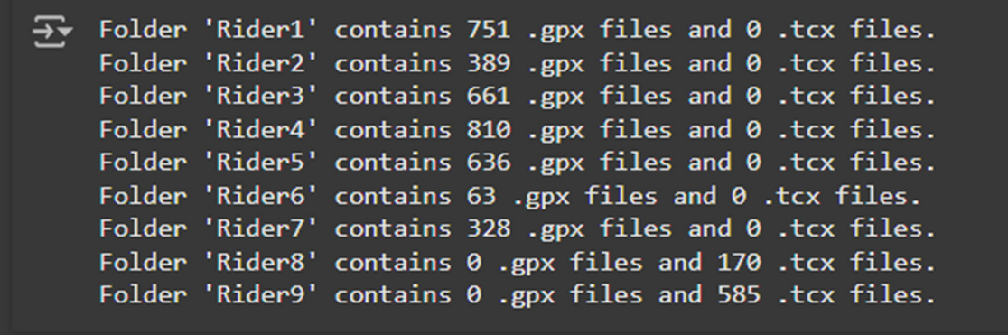
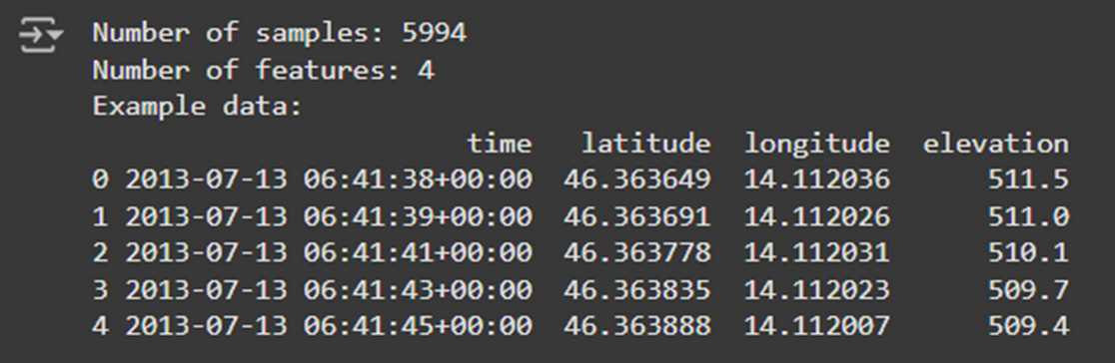


Dataset Characteristics
The dataset was taken from a technical report on nine professional cyclists, with data captured from Garmin or Strava in GPX or TCX file formats.
GPS Location data
Elevation
Duration of activities
Distance Covered
Average and maximal heart rate
Calculated slope, angle, speed
Converted timestamp to absolute time

Slide 6
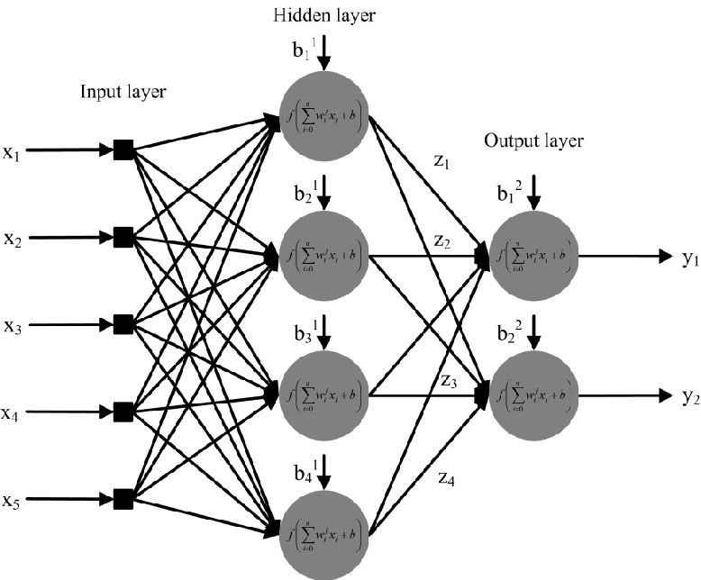
Model Training
Input Features (X) :
The model takes in 6 important features Elevation, Slope, Angle, Distance, Cumulative Slope.
Output Feature (y):
The model predicts the Speed (the actual travel speed), which is used to estimate the accurate travel time.
Model Layers:
Input Layer: Processes the 6 features with 128 neurons.
Hidden Layers: Two layers (with 256 and 128 neurons) help capture complex patterns in how these features affect speed and travel time.
Dropout: Helps prevent overfitting by randomly ignoring parts of the model during training.
Output Layer: The model’s single neuron predicts the travel speed.

Slide 7
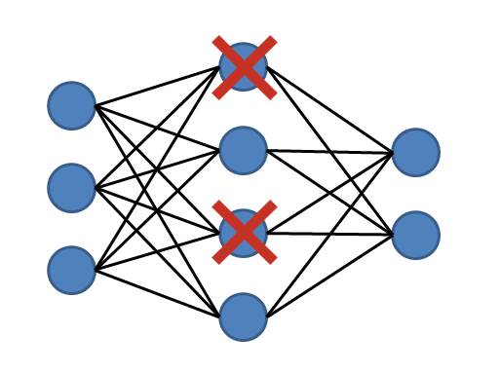
Training:
The model uses Adam optimizer for efficient training and Mean Squared Error to minimize the prediction error.
Callbacks:
Early Stopping: Stops training if the model isn’t improving.
Model Checkpoint: Saves the best model during training.
Learning Rate Scheduler: Adjusts the learning rate if the model is stuck.

Slide 8
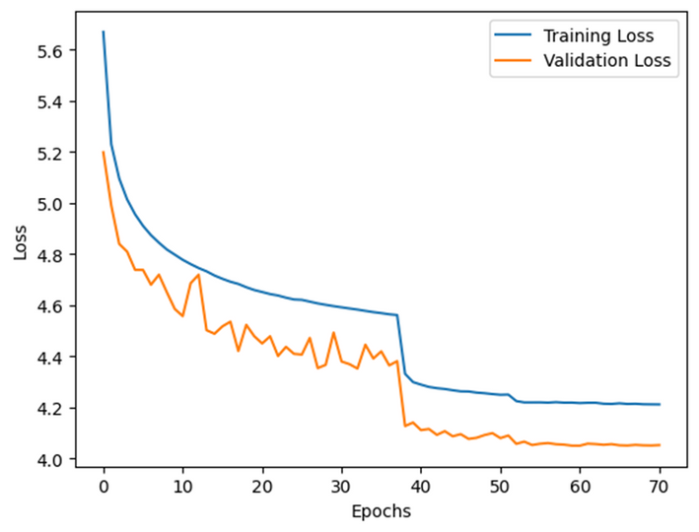
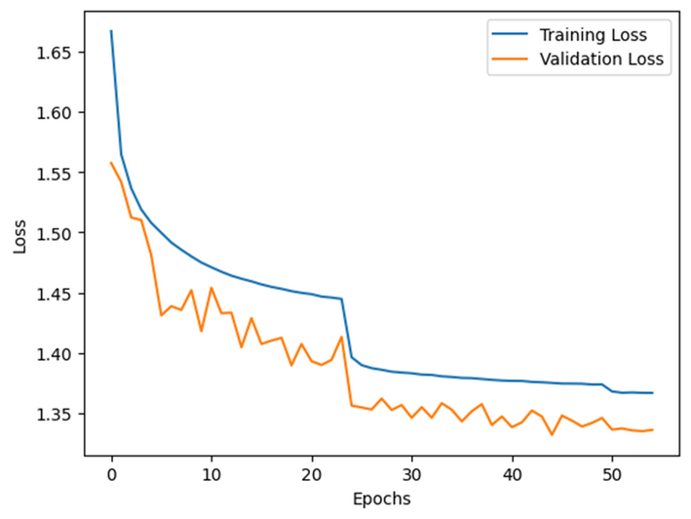
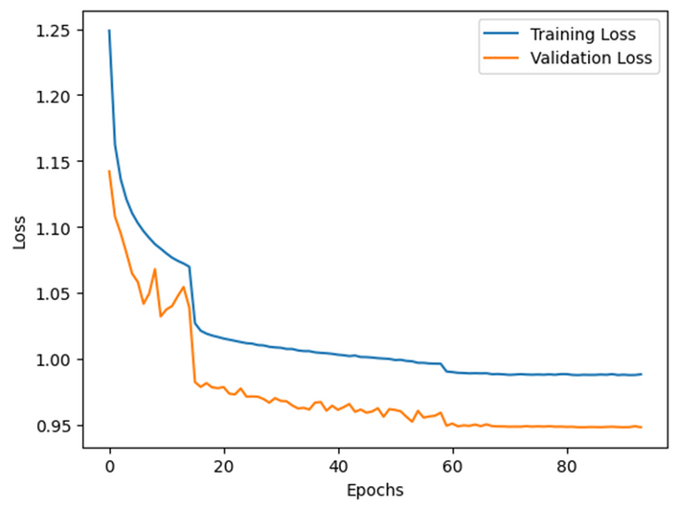
Evaluation Metric
MSE
MAE
Huber

Slide 9
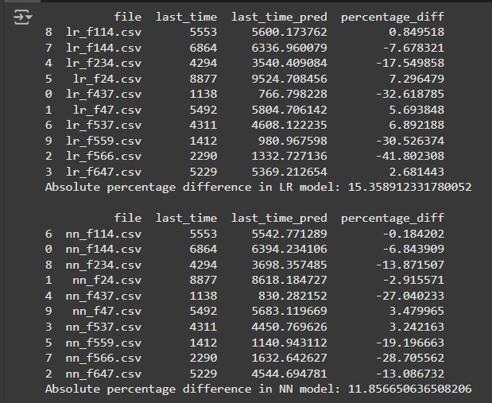
Results
Rider 1
Rider 3
Rider 7
No significant improvement.
LR model: 29.59
NN model: 30.03
Significant improvement.
LR model: 15.35
NN model: 11.85
Significant improvement.
LR model: 26.02
NN model: 13.48

Slide 10

Challenges
Large Dataset:
High computational resources and time required for EDA and preprocessing. Each rider contributed up to 700 GPX files, each with 5,000+ rows.
Data Cleaning:
Filtered errors (e.g., speeds of 700m/s) and handled inconsistent data quality across riders.
Feature Selection:
Key features like slope, angle, and distance proved most effective after meticulous analysis.

Slide 11



Team Members
Maciej
Sai Mohit
Clifford
Msc GeoInformatics
Msc Data Science
Msc Computer Science

Slide 12
Thank you

